Slide 1

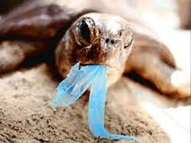
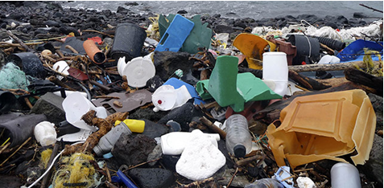
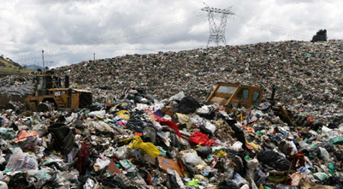
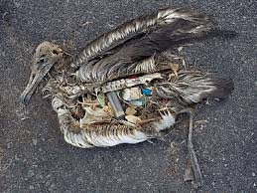

Are you tired about having waste plastics all arround?

Slide 2
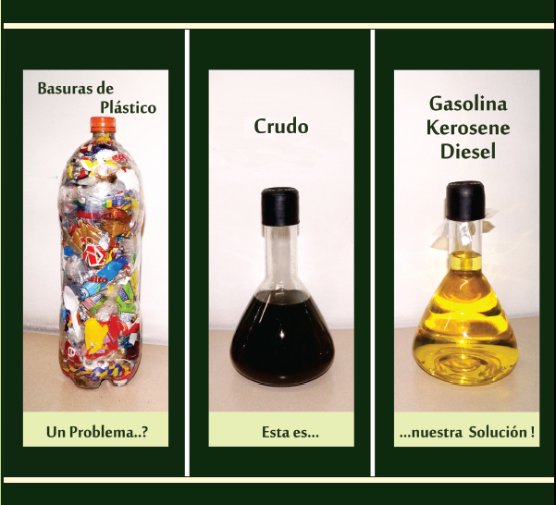
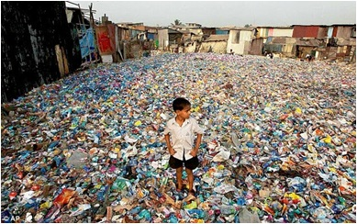
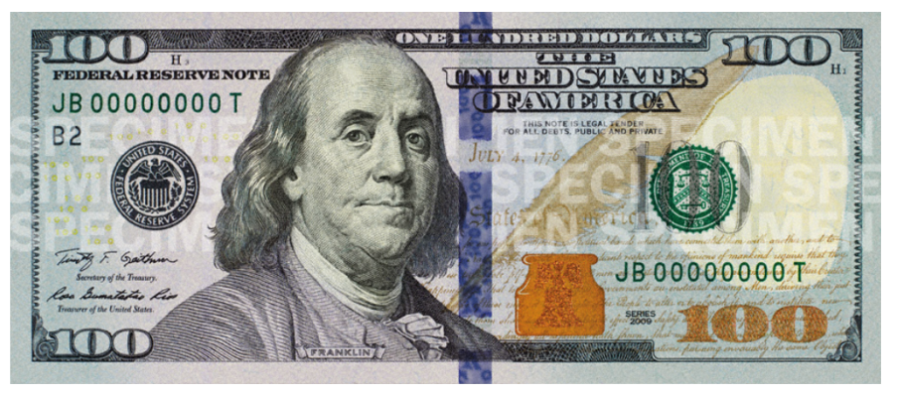

We breach the gap between non recyclable plastics and low cost refined fuels

Slide 3
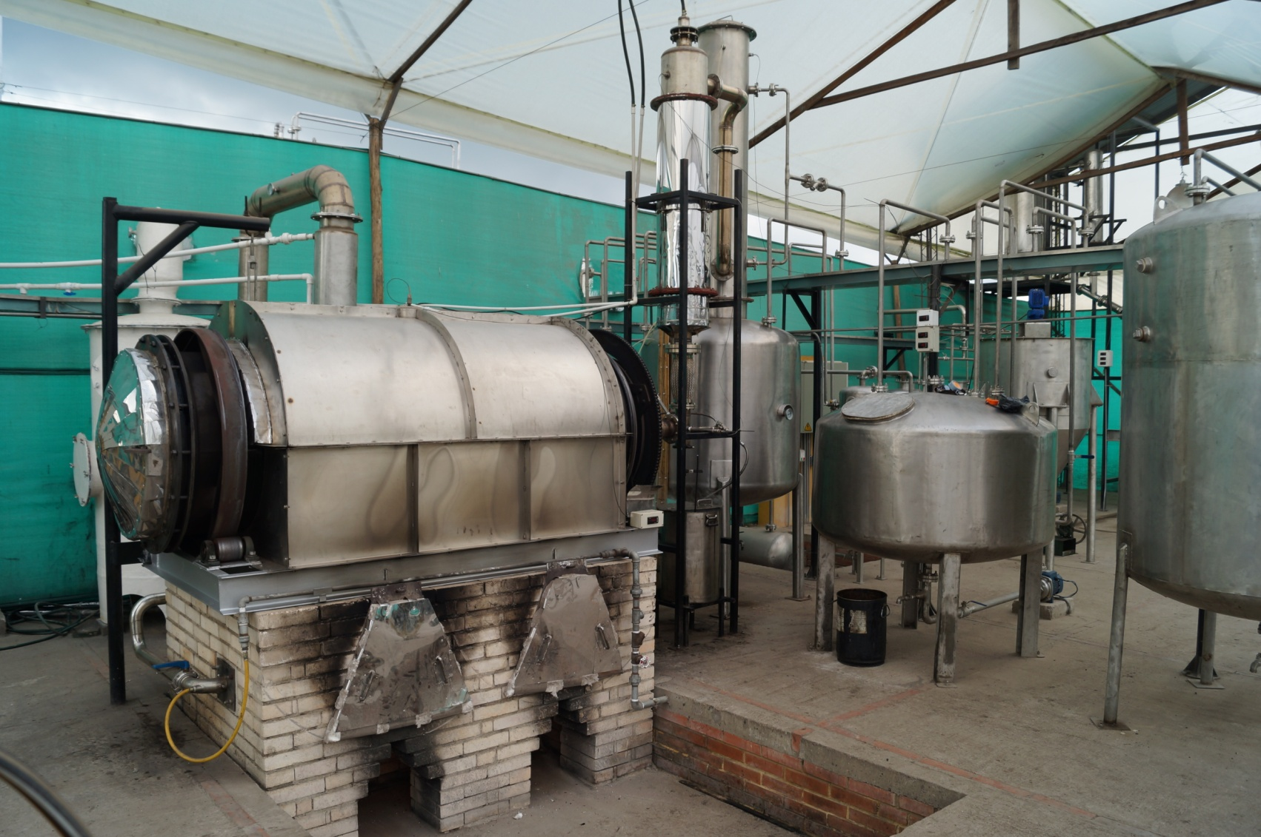
Eco friendly process
Valuing non recycable waste plastics

Slide 4
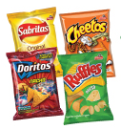
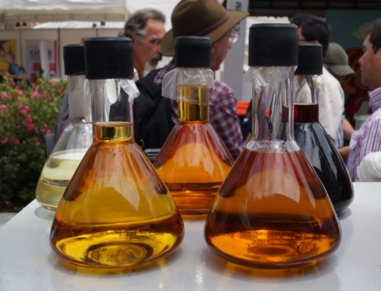
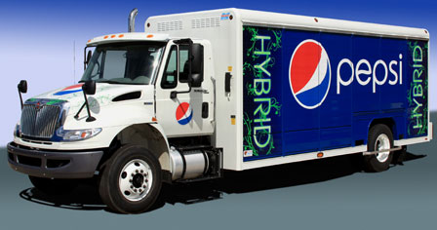
We produce motor fuels at half the market’s retail price

Slide 5






Scailing Path
Scailing and funding
5.000 kg
250 kg
1,5 kg
5 ton per day plant
25.000 gallons ultra light petroleum crude oil monthly
In Bogotá there is enough waste plastics for 100 plants

Slide 6
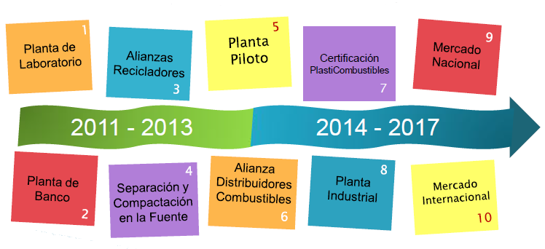
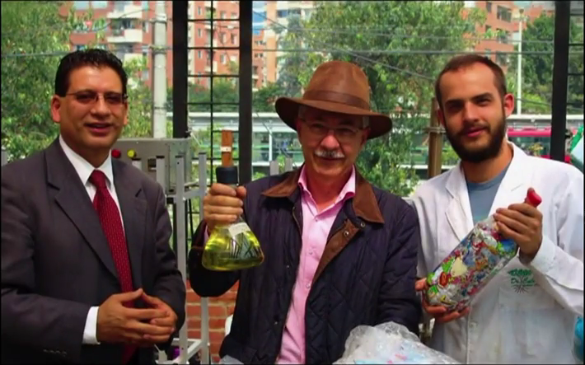


Our Timeline
Our Team
Our Dream

